Slide 1
Solutions of Homework problems

Slide 2
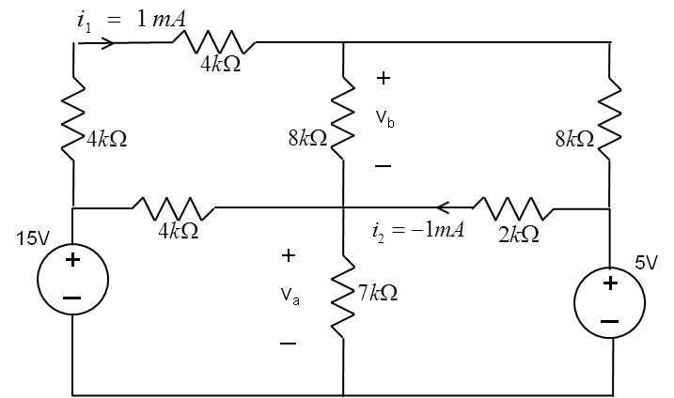
Resistive circuits
Problem 1
Use KVL and Ohms law to compute voltages v_{a} and v_{b} .
-
v₁
From Ohms law:
v₁=8kΩ∗i₁=8[V]
+
v₂=2kΩ∗i₂=-2[V]
Form KVL:
v_{a}=5[V]-v₂=7[V]
v_{b}=15[V]-v₁-v_{a}=0[V]
-
v₂
+
+
+
-
-

Slide 3
Resistive circuits
Problem 2
Write equations to compute voltages v₁ and v₂ , next find the current value of i₁
i₁
From KCL:
50 mA=v₁/40+(v₁-v₂)/40
and
100 mA=v₂/80+(v₂-v₁)/40
i₁
v₁
v₂
50 mA
100 mA
Multiply first equation by 40:
2=v₁+v₁-v₂=2v₁-v₂
From second equation:
8=v₂+2(v₂-v₁)=3v₂-2v₁ add both sides:
10=2v₂ => v₂=5 [V], v₁=1+v₂ /2=3.5[V]
i₁= (v₁-v₂)/40=-1.5/40=37.5 [mA]

Slide 4
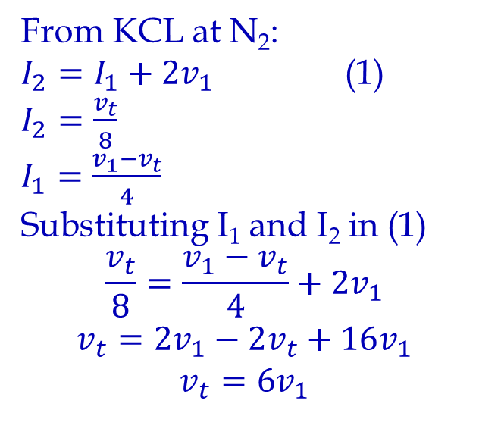
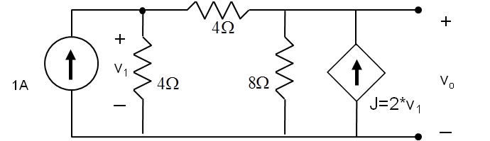
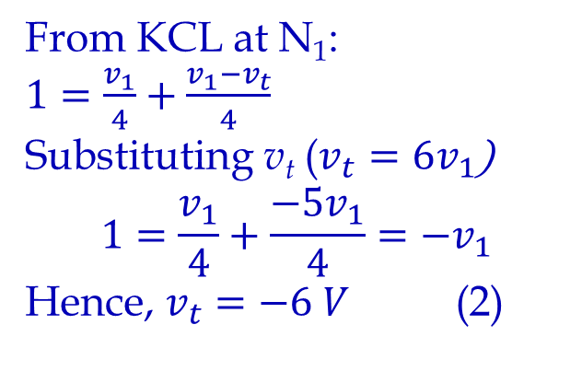
Thevenin & Norton
Problem 3: Find Thevenin and Norton equivalent circuit for the network shown.
N₁
I₁
N₂
I₂
v_{t}
From KVL

Slide 5
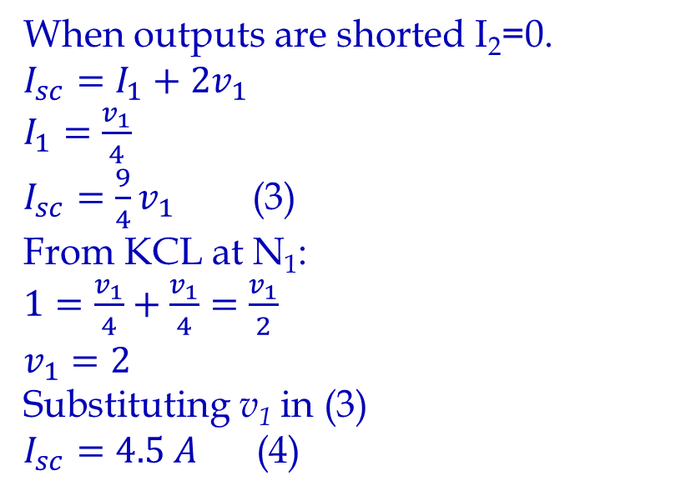
Thevenin & Norton
N₁
I₁
N₂
I₂
I_{sc}
From KVL

Slide 6
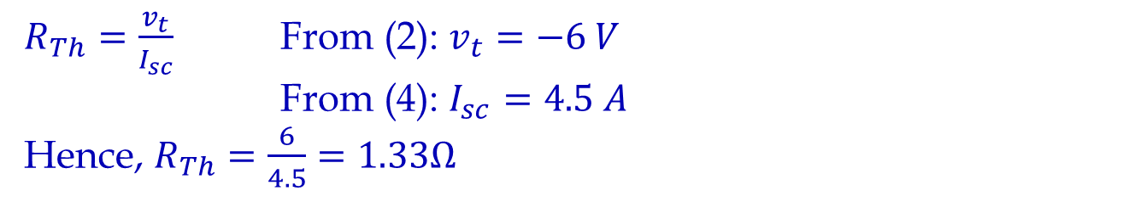
Thevenin & Norton
R_{Th}=v_{t}/I_{sc}=-1.33Ω
Note: Negative v_{t} indicates that the polarity is reversed and as a result this circuit has a negative resistance.
R_{Th}=-1.33Ω
A
A
+
I_{n}=4.5 A
R_{Th}=-1.33Ω
V_{t}=-6 V
_
B
B
Thevenin Equivalent
Norton Equivalent

Slide 7
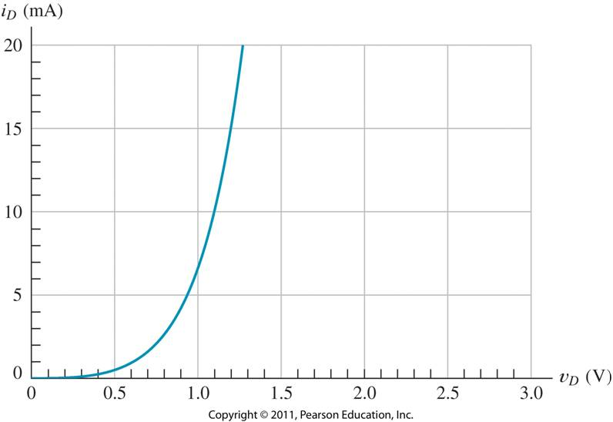
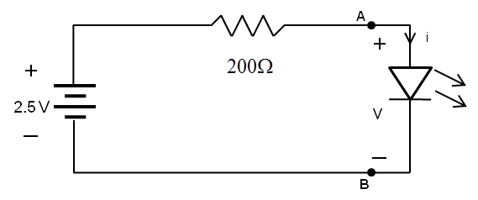
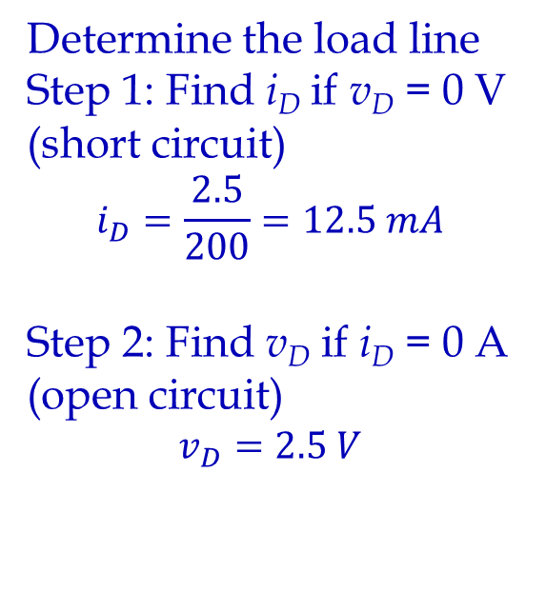
Problem 4: Find the current i and the voltage v across LED diode in the circuit shown on Fig. a) assuming that the diode characteristic is shown on Fig. b).
Draw load line. Intersection of load line and diode characteristic is the i and v across LED diode: v ≈ 1.02 V and i ≈ 7.5 mA.

Slide 8
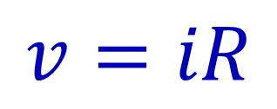
Problem 5: Sketch i versus v to scale for each of the circuits shown below. Assume that the diodes are ideal and allow v to range from -10 V to +10 V.
i
(a)
+
v
_
2kΩ
Diode is on for v > 0 and R=2kΩ.
In a series connection voltages are added for each constant current

Slide 9
Problem 5: Sketch i versus v to scale for each of the circuits shown below. Assume that the diodes are ideal and allow v to range from -10 V to +10 V.
i
(a)
+
v
_
2kΩ
Resulting characteristics

Slide 10
Problem 5: Sketch i versus v to scale for each of the circuits shown below. Assume that the diodes are ideal and allow v to range from -10 V to +10 V.
(b)
i
1kΩ
Due to the presence of the 5V supply the diode conducts only for v > 5, R = 1kΩ
+
v
_
+
_
5V
First combine diode and resistance then add the voltage source

Slide 11
Problem 5: Sketch i versus v to scale for each of the circuits shown below. Assume that the diodes are ideal and allow v to range from -10 V to +10 V.
i
(c)
+
v
_
2kΩ
1kΩ
A
B
Diode B is on for v > 0 and R=1kΩ.
Diode A is on for v < 0 and R=2kΩ.

Slide 12
Problem 5: Sketch i versus v to scale for each of the circuits shown below. Assume that the diodes are ideal and allow v to range from -10 V to +10 V.
i
(d)
+
v
_
D
C
1kΩ
Diode D is on for v > 0 and R=1kΩ.
Diode C is on for v < 0 and R=0Ω.

Slide 13
Problem 6: Assuming ideal diodes sketch to scale the transfer characteristics (v_{o} versus v_{in}) for the circuit shown below.
1kΩ
+
v_{o}
_
1kΩ
v_{in}
+
_
3V
+
v_{o}
_
1kΩ
v_{in}
+
_
Case I: v_{in} > 0
Both diodes are on, and act as short circuits. The equivalent circuit is shown here.
v_{o} = v_{in}

Slide 14
Problem 6: Assuming ideal diodes sketch to scale the transfer characteristics (v_{o} versus v_{in}) for the circuit shown below.
Case II: v_{in} < 0
Both diodes are reverse biased and v_{o} is the sum of the voltage drops across Zener diode and 1kΩ resistor.
1kΩ
+
v_{o}
_
1kΩ
v_{in}
+
_
3V
1kΩ
+
v_{o}
_
1kΩ
v_{in}
+
_
3V

Slide 15
Problem 6: Assuming ideal diodes sketch to scale the transfer characteristics (v_{o} versus v_{in}) for the circuit shown below.
Case II: v_{in} < 0
Both diodes are reverse biased and v_{o} is the sum of the voltage drops across Zener diode and 1kΩ resistor.
1kΩ
+
v_{o}
_
1kΩ
v_{in}
+
_
3V
Case IIa: -3V < v_{in} < 0
v_{o} = v_{in}, because the current through Zener diode is zero, all negative voltage drop is across the Zener diode.
1kΩ
+
v_{o}
_
1kΩ
v_{in}
+
_

Slide 16
Problem 6: Assuming ideal diodes sketch to scale the transfer characteristics (v_{o} versus v_{in}) for the circuit shown below.
v_{o}
1kΩ
+
v_{o}
_
1
1kΩ
1
v_{in}
+
_
-3V
v_{in}
-3V
+
_
-3V
Case IIb: v_{in} < -3V
Excess voltage below -3V is dropped across the two resistors (1kΩ and 1kΩ), with
v_{o} = (1/2)*(v_{in}+3)-3= v_{in}/2-1.5 [V].
1
2

Slide 17
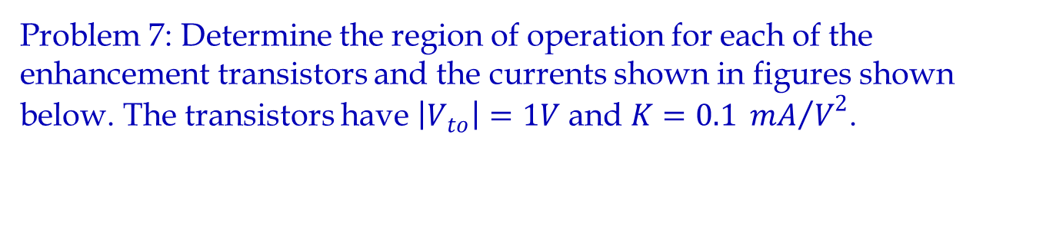
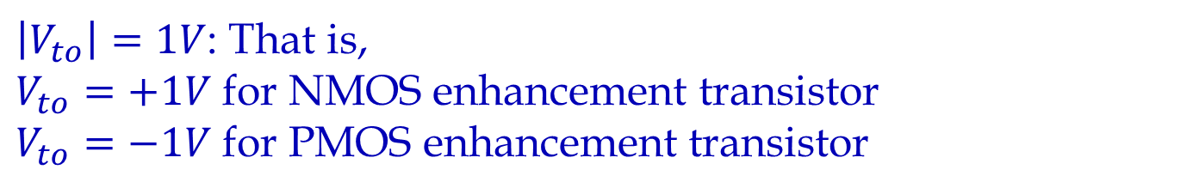
(a)
+
5V
+
-
4V
I_{a}
-

Slide 18
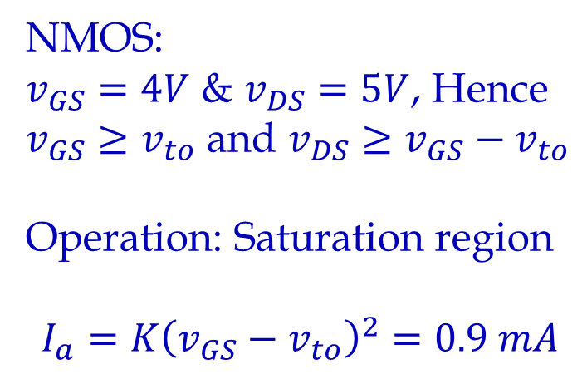
D
(a)
+
G
5V
+
-
4V
I_{a}
-
S

Slide 19
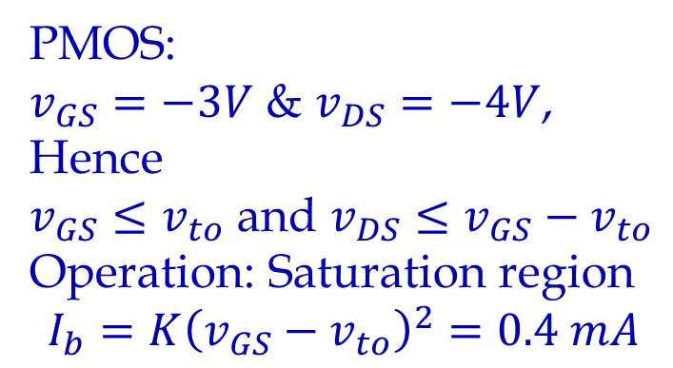
(b)
+
S
3V
I_{b}
-
G
+
1V
-
D

Slide 20
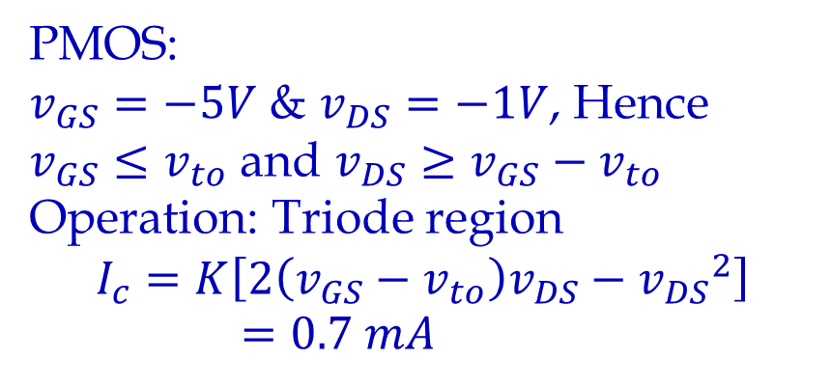
(c)
+
S
5V
I_{c}
G
-
-
4V
c
+
D

Slide 21
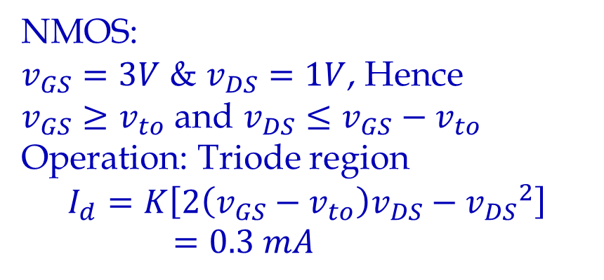
(d)
D
I_{d}
G
+
1V
+
-
3V
-
S

